Slide 1
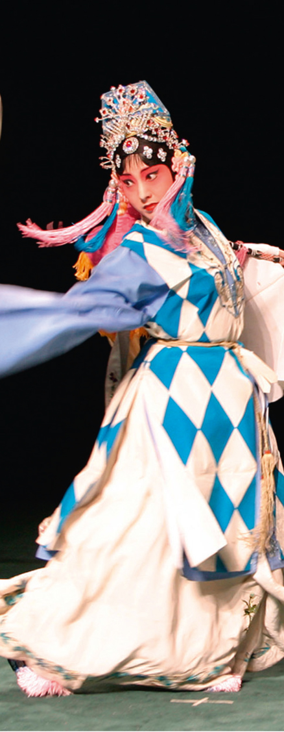
Introducing
Heritage Treasures: An In-Depth Analysis of UNESCO World Heritage Sites in Tableau
DONE BY DHEEKSHITHA AND BHANU PRAKASH

Slide 2
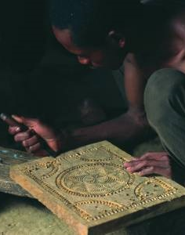
In this presentation …
UNESCO and its Conventions
  The Intangible Heritage Convention
  Purposes of the Convention
  Organs of the Convention
  Two Lists and a Register
  Operational Directives (ODs)
  ICH Fund
  Obligations and benefits
The Woodcrafting Knowledge of the Zafimaniry
© J. Ségur/ZED
Inscribed on the RL in 2008
© All Rights Reserved: UNESCO

Slide 3
UNESCO and its Conventions
Intergovernmental organization with 195 Member States
Five sectors: Education, Natural Sciences, Social & Human Sciences, Culture and Communication & Information
Seven UNESCO Conventions in the fields of culture and heritage:
tangible, intangible and natural heritage
diversity of cultural expressions
copyright
© All Rights Reserved: UNESCO

Slide 4
Three related UNESCO Conventions on culture and heritage
There are three related UNESCO conventions on culture and heritage:
Convention concerning the Protection of the World Cultural and Natural Heritage (1972)
Convention for the Safeguarding of the Intangible Cultural Heritage (2003)
Convention on the Protection and Promotion of the Diversity of Cultural Expressions (2005)
© All Rights Reserved: UNESCO

Slide 5
Comparing two Conventions (1)
World Heritage (1972)
Conservation of World Heritage properties
Cultural and/or natural
Outstanding universal value
Authenticity and integrity help to define value, often restricting change
Intangible Heritage (2003)
Safeguarding of all ICH expressions, skills, practices and knowledge
Cultural and/or social
Communities concerned define value
ICH changes over time
© All Rights Reserved: UNESCO

Slide 6
Comparing two Conventions (2)
Diversity of Cultural Expressions (2005)
Cultural activities, goods and services (products)
Cultural expressions: often new, individual creations
Focus on cultural industries, dissemination and development
Intangible Heritage (2003)
Skills, practices, expressions and knowledge
ICH is a collective practice, transmitted ‘from generation to generation’
Focus on safeguarding practice and transmission of ICH
© All Rights Reserved: UNESCO

Slide 7
Contents of the Intangible Heritage Convention
Preamble
Purposes of the Convention (Article 1)
Definitions (Article 2)
Organs of the Convention (Articles 4–10)
Safeguarding – national level (Articles 11–15)
Lists and Register (Articles 16–18)
International cooperation and assistance (Articles 19-24)
ICH Fund (Articles 25–28)
Reporting (Articles 29–30)
Ratification, etc. (Articles 32–33)
© All Rights Reserved: UNESCO

Slide 8
Objectives of the Convention
  Article 1
Safeguarding
Respect
Awareness and mutual appreciation
International cooperation and assistance
© All Rights Reserved: UNESCO

Slide 9
The two Lists of the Convention
Representative List of the Intangible Cultural Heritage of Humanity – RL (Article 16)
List of Intangible Cultural Heritage in Need of Urgent Safeguarding – USL (Article 17)
© All Rights Reserved: UNESCO

Slide 10
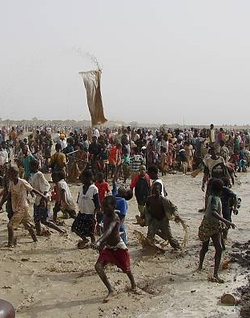
Sanké mon: collective fishing rite of the Sanké
The Sanké mon collective fishing rite takes place annually in the Ségou region of Mali to mark the beginning of the rainy season and commemorate the founding of the town of San.
In recent years, fewer people have attended the rite because of diminishing awareness of its function and history, occasional accidents and the degradation of the Sanké lake.
Inscribed on the USL in 2009.
© Direction Nationale du Patrimoine Culturel, Ministère de la Culture du Mali, 2009
© All Rights Reserved: UNESCO

Slide 11
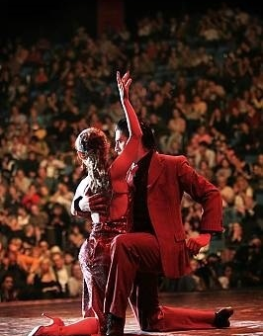
The Tango
The Tango is a symbol of the popular culture of Argentina and Uruguay, especially their capital cities. Originating in the working-class neighbourhoods of Buenos Aires and Montevideo, the Tango dates back to the late nineteenth century. Practised spontaneously and in more formal settings, it enjoys great popularity, both locally and worldwide.
Inscribed on the RL in 2009.
© Ministerio de Cultura de Argentina, Ciudad de Buenos Aires, 2008
© All Rights Reserved: UNESCO

Slide 12
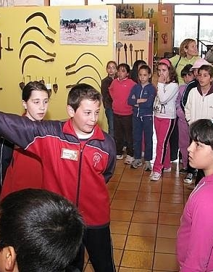
Register of Best Safeguarding Practices
Article 18
School Museum of Pusol (Spain)
Guided by teachers, children explore the rich heritage of Elche by working with tradition bearers and documenting their heritage.
© Centre for Traditional Culture, School Museum of Pusol, 2010
© All Rights Reserved: UNESCO

Slide 13
Organs of the Convention
Intergovernmental Committee:
twenty-four Member States; implements the Convention.
General Assembly: sovereign body of the Convention. All States Parties are members.
UNESCO Secretariat: serves the Organs; assists in implementing the Convention.
© All Rights Reserved: UNESCO

Slide 14
Operational Directives
Guide implementation of the Convention
Include regulations and procedures for Lists, Register and Fund as well as reporting obligations
Prepared by Committee, approved by General Assembly
First set approved 2008; amended and enlarged in 2012 and 2014
© All Rights Reserved: UNESCO

Slide 15
Intangible Cultural Heritage Fund
Articles 25–28
Mainly supports safeguarding, inventory-making, capacity building
States Parties contribute to the Fund
Some States make additional contributions
States Parties may request financial assistance, singly or jointly
Few requests for assistance received so far
© All Rights Reserved: UNESCO

Slide 16
Exercise (20 mins): obligations of States Parties to the Convention
In Articles 11–15 and 26–29 of the Convention, please identify where it says:
‘States Parties shall ...’
‘States Parties undertake …’
‘States Parties shall endeavour to ...’
© All Rights Reserved: UNESCO

Slide 17
Obligations of States Parties to the Convention
Safeguard ICH on their territory (Article 11(a))
Ensure community participation in identifying, defining and managing their ICH (Articles 11(b) and 15)
Draw up inventories of the ICH in their territory (Article 12.1)
Contribute to the ICH Fund (Article 26)
Report to the Committee (Article 29)
© All Rights Reserved: UNESCO

Slide 18
Benefits of implementing the Convention (1)
Better safeguarding of the ICH within the States Parties, contributing to:
Well-being of communities
Respect and understanding between communities
Sustainable development
Enhancement of cultural diversity and human
creativity
© All Rights Reserved: UNESCO

Slide 19
Benefits of implementing the Convention (2)
International cooperation and assistance:
Sharing expertise and information internationally
Sharing safeguarding practices
Accessing assistance from the Fund
Nominating elements and safeguarding projects
Participating in the Organs of the Convention
Cooperating regionally and internationally: for example, on shared heritage
© All Rights Reserved: UNESCO

Slide 20
In conclusion
The Convention aims at:
Safeguarding ICH within and by communities in a context of sustainable development and mutual respect
Fully involving communities in any action concerning their ICH and empowering communities
Enhancing cultural diversity, human creativity, mutual understanding and international cooperation
© All Rights Reserved: UNESCO

